Slide 1
Somalia & islam
Aden Batar

Slide 2
Somalia culture corner

Slide 3
Facts
Population 17 million
GDP $13.3 billion
Currency Somali Shillings
Agriculture 65% of the GDP
Coastline 3,333 km the largest in mainland Africa
Major Cities Mogadishu, Baidoa, Hargeisa, Kismayo
Language Somali, Arabic, Italian, Swahili & English
Religion Muslim
Clans Somali people are divided into clans

Slide 4
Background
Somalia is a hot, arid country on the eastern coast of Africa,
Bordered by Ethiopia, Kenya, and Djibouti
Somalia were colonized by Britain, Italy, and France,
Gain independence on July 1, 1960
Somalia has experienced civil war on and off since 1991
Nearly two million Somali refugees live outside their country, and more than 5 million have been displaced within their own country
The U.S. has resettled more than 100,000 Somali refugees across the country
The U.S. continues to resettle Somali refugees. These are often single mothers with young children

Slide 5
Culture & Religion
The Somalis are Sunni Muslims
Islamic faith is central to Somali culture and dates back the beginning of Islam
Somalis will observe the following religious/ cultural practices:
Women covering their arms and legs and wearing the “hijab” (head covering) in public—reflecting the values of modesty and purity
Abstaining from pork and alcohol
Eating only “halal” meat (regarding the way animals are slaughtered, similar in some ways to “kosher” meat preparation)
Somali men and women may avoid touching or shaking hands with unrelated people from the opposite gender
A common greeting is “As-salamu Alaikum” [sa-lam a-leikum], Arabic for “peace be upon you.”
“Iska Waram” is the traditional Somali greeting for “How are you?”
Strong social networks are an important strength of Somali culture.
Somali families are traditionally large and multi-generational and often live together
Somalia is a clan-based society
Marriage is considered a relationship between two families or clans
Traditionally men have worked outside the home, while women have taken responsibility for children and the household.

Slide 6
Culture continued
Somalis typically have 3 names: given name; father’s given name; and paternal grandfather’s given name
Women do not change their maiden name
Nicknames are commonly used to distinguish between people with similar names
Education is highly valued within Somali families
Culturally, mental health is typically viewed as being either “crazy ” or “sane,”

Slide 7
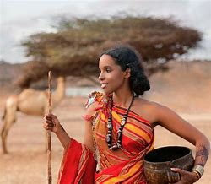
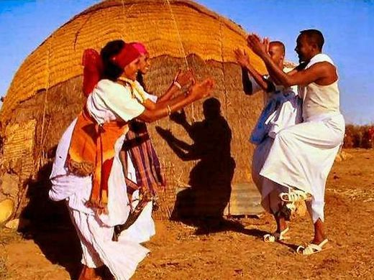
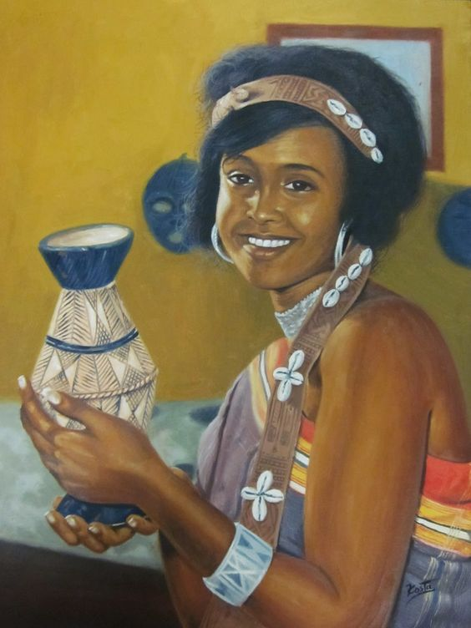
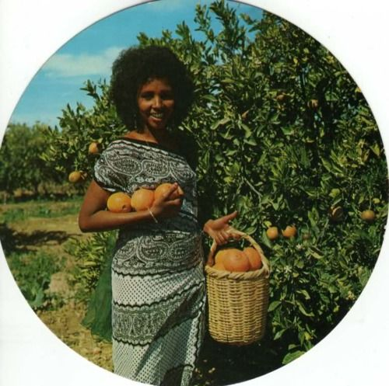
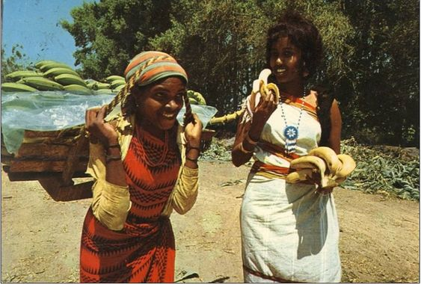

Slide 8
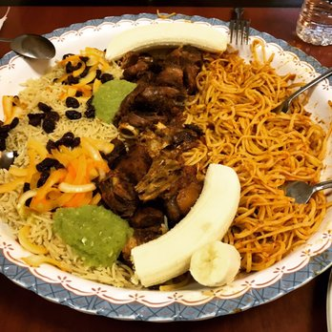
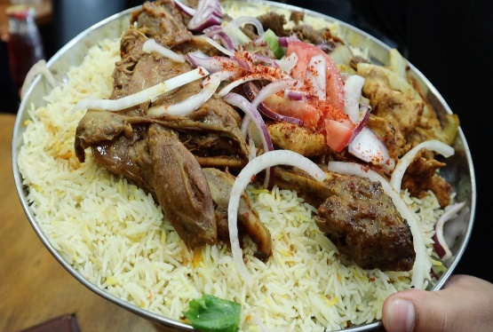
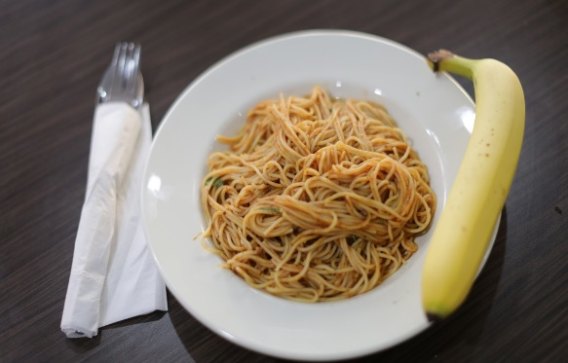
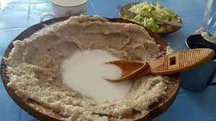
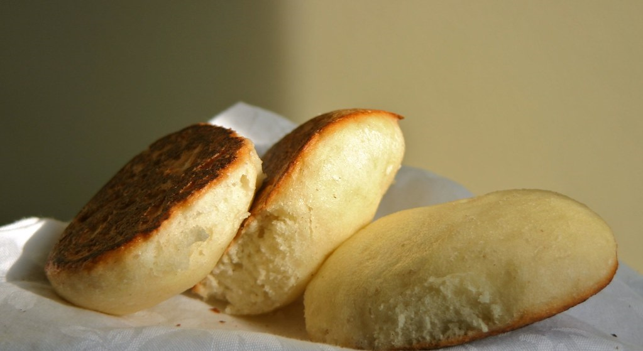
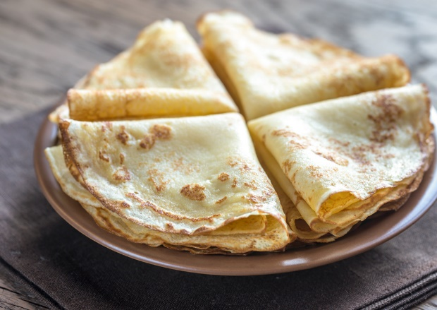
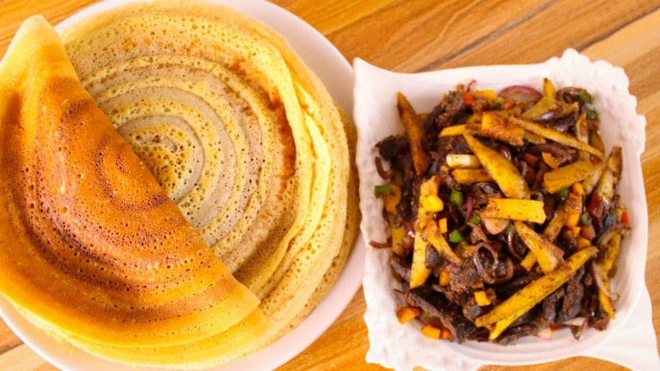
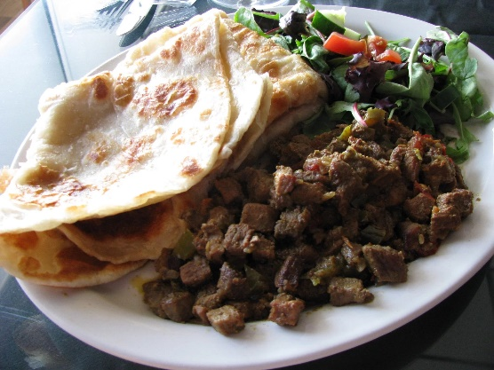
Somali Food

Slide 9
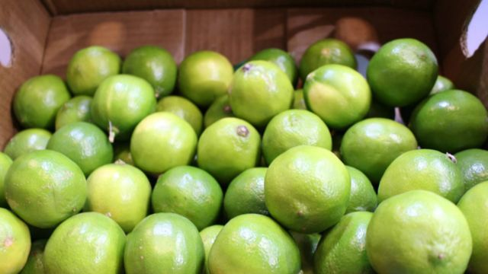
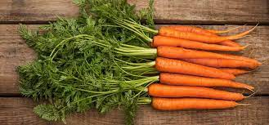
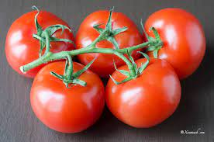
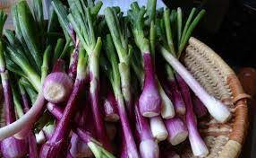
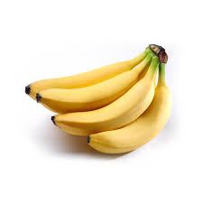
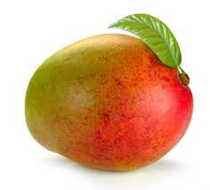
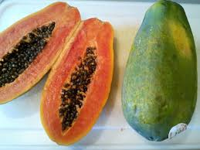
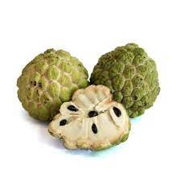
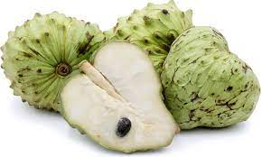
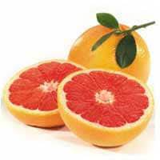
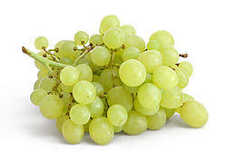
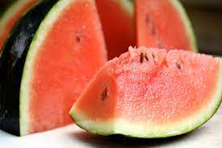
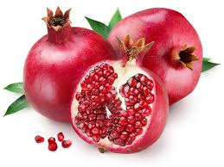
Vegetables and Fruits

Slide 10
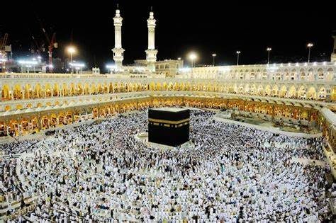
ISLAM

Slide 11
What is Islam and Muslim
The word “Islam” is an Arabic word that means both “surrender” and “peace”
Muslims call Islam as their religion
The word “Muslim” means “one who submits to Allah (God)”

Slide 12
Muslim Population
Over 2 billion Muslims in the world
The second largest religion after Christianity
Muslims live in different countries, language, & culture
Islam is what unites all Muslims
Largest Muslim countries
Indonesia, Pakistan, India, and Bangladesh
20% in Arab countries
15% in Africa
6% in Europe

Slide 13
Muslim Greeting
Aslamu Alaikum – Means “Peace be with you”
Wa Alaikum Salaam – Means “Peace be with you as well”

Slide 14
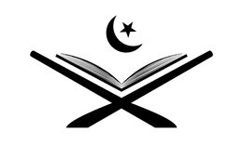
Holy Book
The Islamic holy book is called “Quran”
It is the exact words from Allah (God)
It is only one version
All Islamic tradition and cultures are based on Quran
Muslims also follow “Sunnah” Prophet Mohamed’s way of life

Slide 15
Five Pillars of Islam
Shahadah:
declaration of faith "I bear witness that there is no god, but God; I bear witness that Muhammad is the prophet of God.“
Salah:
Prayer - 5 times a day facing Mecca, cleanse before praying
Zakat:
Giving to charity - 2.5% of wealth every year
Saum:
Fasting during the month of Ramadan - Fast for purification
Hajj:
Pilgrimage to Mecca - at least once in a Muslim’s lifetime if one can afford

Slide 16
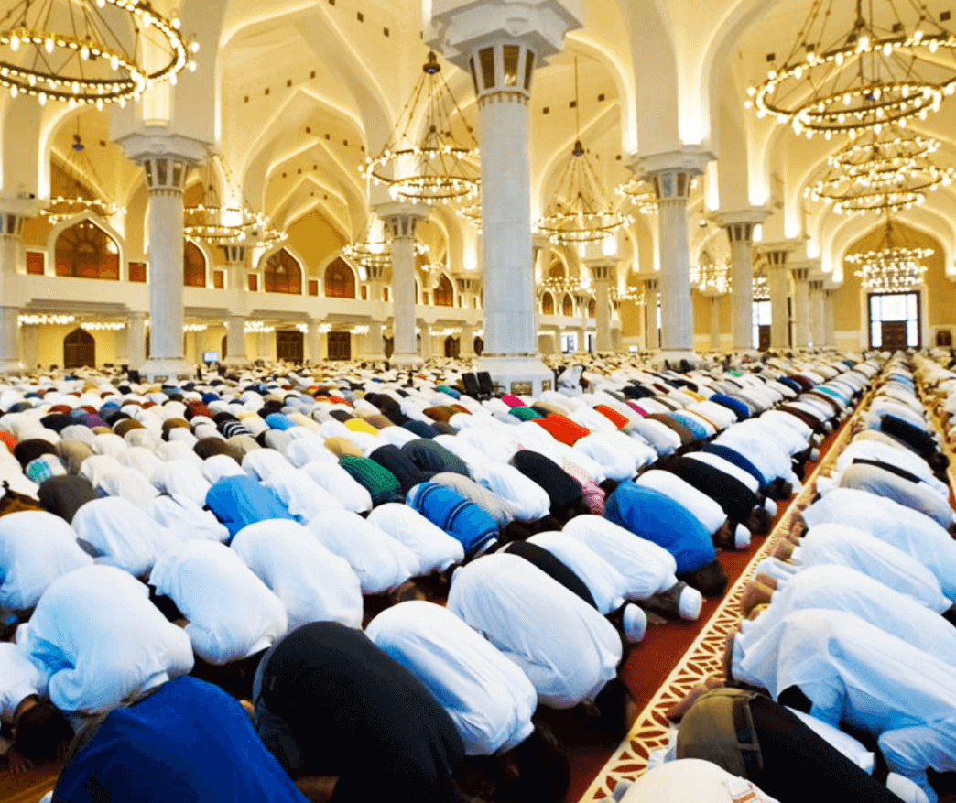
Salat - Prayer
Fajr: Before sunrise
Dhuhr: After noon
Asr: Late afternoon
Maghrib: Just after sunset
Isha: Before going to bed

Slide 17
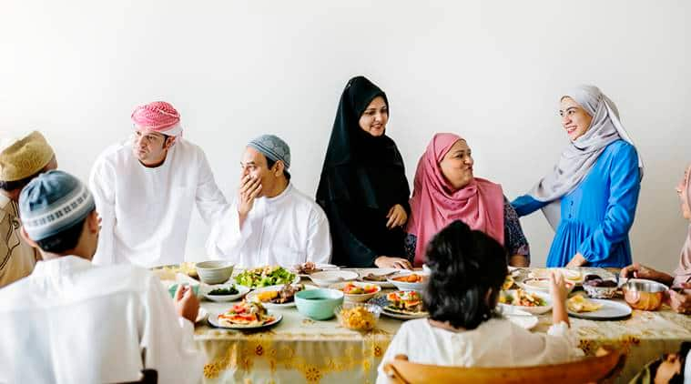
Muslim Holidays
Eid-ul-Fitr – After Ramadan
Eid-ul-Adha – When Muslims finish their Pilgrimage

